Slide 1
W4111 – Introduction to Databases Section 002, Fall 2021 Lecture 2: ER, Relational, SQL (I)
© Donald F. Ferguson, 2021

Slide 2
W4111 – Introduction to Databases Section 002, Fall 2021 Lecture 2: ER, Relational, SQL (I)
We will start in a couple of minutes.
© Donald F. Ferguson, 2021

Slide 3

Contents
3 | COMS W4111_002_2021_3: Lecture 2: ER, Relational, SQL (I) © Donald F. Ferguson, 2021

Slide 4
Contents
Introduction: comments, questions and answers
Motivating Sample Problems:
Bottom-Up: IMDB, Game of Thrones
Top-Down: Columbia University/Sample University
ER (Diagram) Modeling (Chapter 6)
The Relational Model and Algebra (Chapter 2)
SQL (Chapter 3)

Slide 5
Questions, Answers, Comments
5 | COMS W4111_002_2021_3: Lecture 2: ER, Relational, SQL (I) © Donald F. Ferguson, 2021

Slide 6
TBD
Answer interesting questions from discussion forum.
Answer questions from the class.

Slide 7
Motivating Problems
7 | COMS W4111_002_2021_3: Lecture 2: ER, Relational, SQL (I) © Donald F. Ferguson, 2021

Slide 8
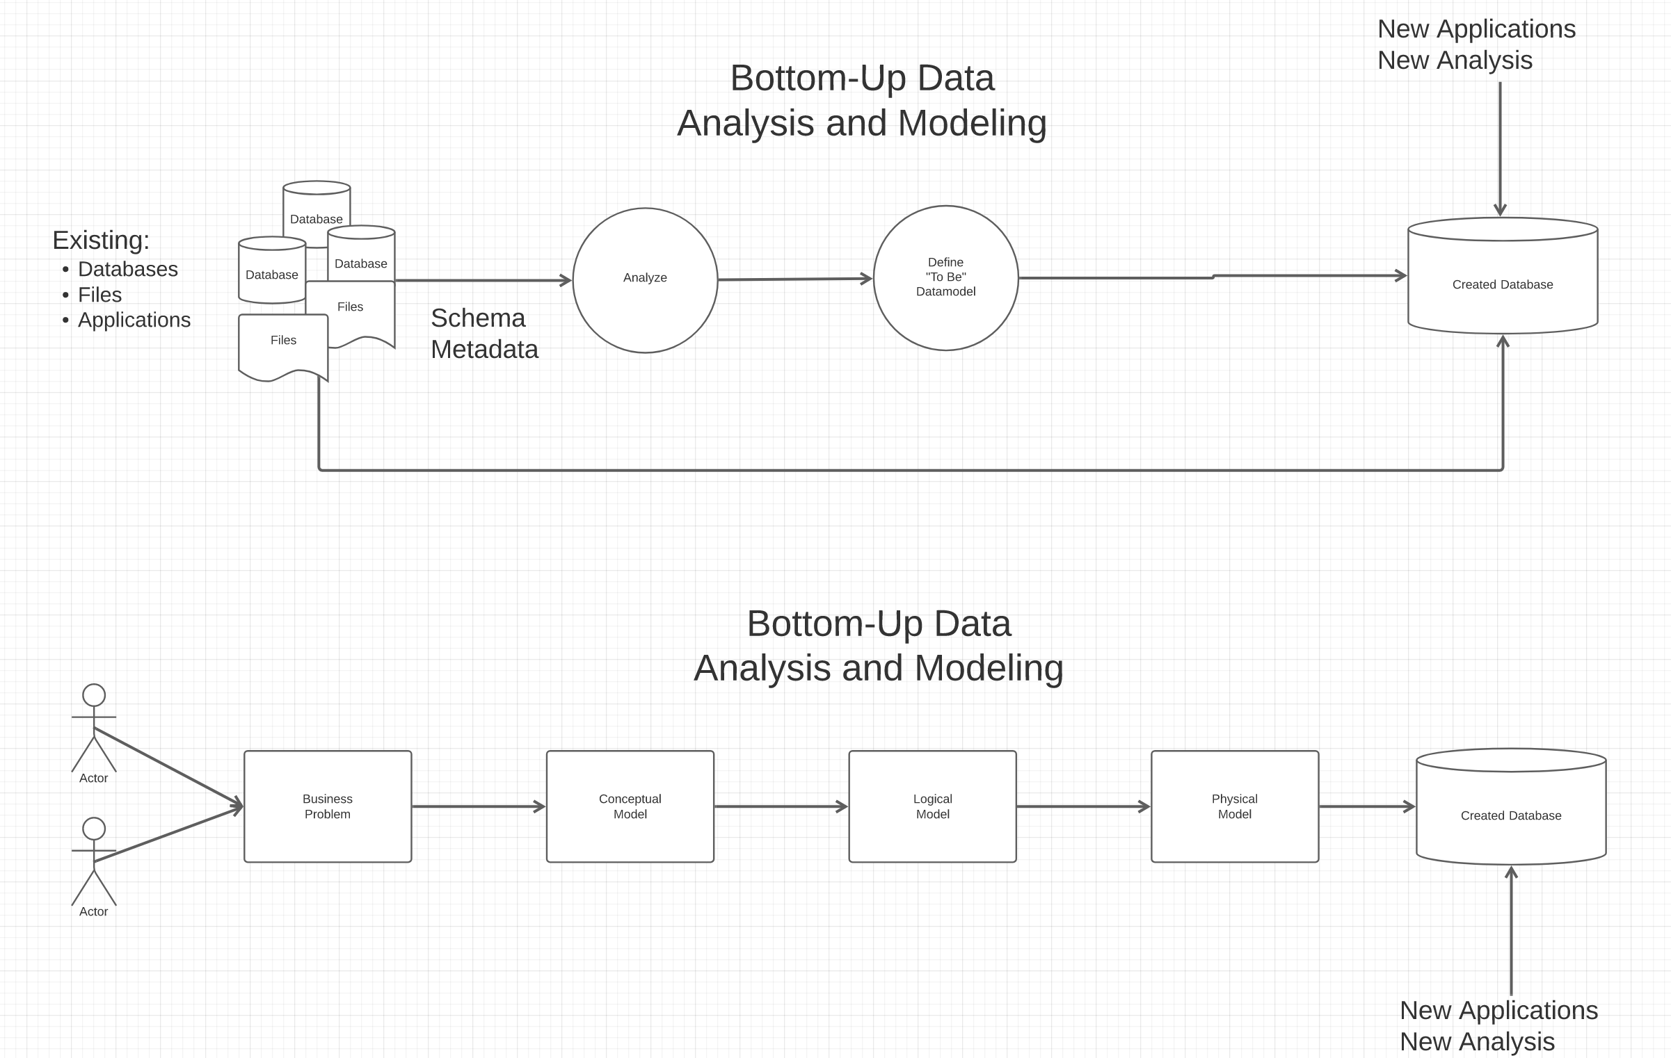
Top-Down and Bottom-Up Data Modeling
The most common is meet-in-the-middle:
Top-down defines the end state.
Bottom-up defines how to get there.

Slide 9
Bottom-Up: Game of Thrones and IMDB
Several files from IMDB:
Titles Basics
Titles AKAS
Titles Episodes
Titles Crews
Title Principals
Title Ratings
Name Basics
Tab Separated Value
To Be Data Model and DB
Game of Thrones: (https://jeffreylancaster.github.io/game-of-thrones/)
Characters, Genders, Groups
Episodes
Locations, Opening Locations
Words: Script, Bag, ... ...
Geography
... ...
JSON

Slide 10
Take a Look
Open Jupyter Notebook

Slide 11
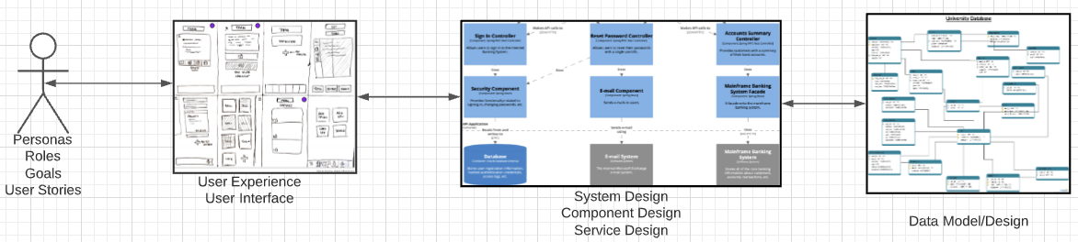
Top-Down: University Management
We must build a system that supports academic operations in a university.
There are two major domains:
Interactive operations, e.g. register, choose class, assign grade, ... ...
Insight and reporting, e.g. enrollment trends, overloaded resources, ... ...
We will design, develop, test and deploy the system iteratively and continuously.
There are four core domains.
The processes are iterative, with continuous extension and details. We will obviously focus on the data aspects in a database course.
In this course,
We focus on the data dimension.
We will get some insight into the other dimensions.

Slide 12
Database design, Entity-Relationship Model (Part 1)
12 | COMS W4111_002_2021_3: Lecture 2: ER, Relational, SQL (I) © Donald F. Ferguson, 2021

Slide 13

Concepts
13 | COMS W4111_002_2021_1: Lecture 2: ER, Relational, SQL (II) © Donald F. Ferguson, 2021

Slide 14
Design Phases
Initial phase -- characterize fully the data needs of the prospective database users.
Second phase -- choosing a data model
Applying the concepts of the chosen data model
Translating these requirements into a conceptual schema of the database.
A fully developed conceptual schema indicates the functional requirements of the enterprise.
Describe the kinds of operations (or transactions) that will be performed on the data.
DFF Comments:
We you see slides with this formatting, the come directly from the presentations associated with the textbook. (https://www.db-book.com/db7/slides-dir/index.html)
The number at the bottom is of the form chapter.slide_no.
I try to put my comments, modifications and annotations in red text, or inside a red rectangle/callout.

Slide 15
Design Phases (Cont.)
Final Phase -- Moving from an abstract data model to the implementation of the database
Logical Design – Deciding on the database schema. Database design requires that we find a “good” collection of relation schemas.
Business decision – What attributes should we record in the database?
Computer Science decision – What relation schemas should we have and how should the attributes be distributed among the various relation schemas?
Physical Design – Deciding on the physical layout of the database
Notes:
15

Slide 16
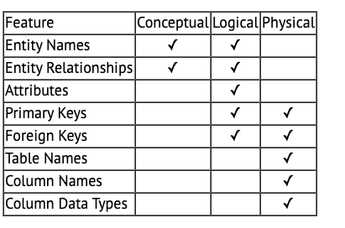
A Common and my Approach: Conceptual → Logical → Physical
https://ehikioya.com/conceptual-logical-physical-database-modeling/
https://www.1keydata.com/datawarehousing/data-modeling-levels.html
It is easy to get carried away with modeling. You can spend all your time modeling and not actually build the schema.
We will use the approaches in class.
Mostly to understand concepts and patterns.
https://www.1keydata.com/datawarehousing/data-modeling-levels.html

Slide 17
ER model -- Database Modeling
The ER data mode was developed to facilitate database design by allowing specification of an enterprise schema that represents the overall logical structure of a database.
The ER data model employs three basic concepts:
entity sets,
relationship sets,
attributes.
The ER model also has an associated diagrammatic representation, the ER diagram, which can express the overall logical structure of a database graphically.

Slide 18
Entity Sets
COMS W4111 002 01 2021
An entity is an object that exists and is distinguishable from other objects.
Example: specific person, company, event, plant
An entity set is a set of entities of the same type that share the same properties.
Example: set of all persons, companies, trees, holidays
An entity is represented by a set of attributes; i.e., descriptive properties possessed by all members of an entity set.
Example:
instructor = (ID, name, salary ) course= (course_id, title, credits)
A subset of the attributes form a primary key of the entity set; i.e., uniquely identifying each member of the set.
DFF Comments:
Some of these statements apply primarily to OO systems and the relational/SQL models.
A motivation for “No SQL” is to relax the constraints.

Slide 19
Entity Sets -- instructor and student

Slide 20
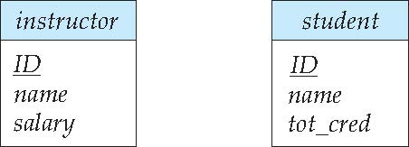
Representing Entity sets in ER Diagram
Entity sets can be represented graphically as follows:
Rectangles represent entity sets.
Attributes listed inside entity rectangle
Underline indicates primary key attributes

Slide 21
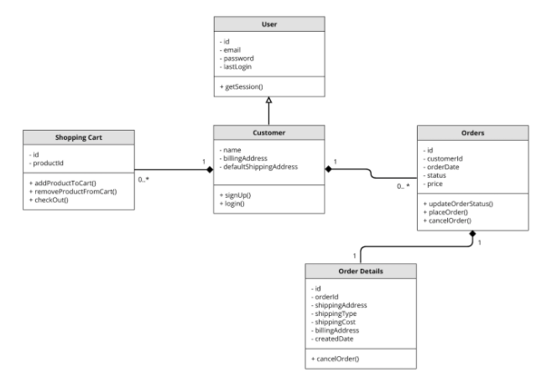
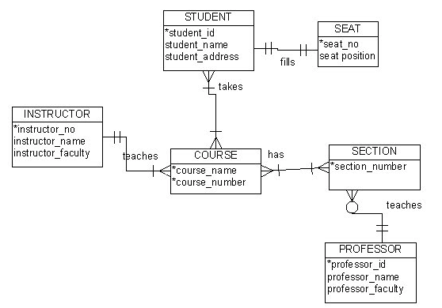
Visual Notation – Many Notations
ER Model
UML
“Other,” i.e. PowerPoint is the most common modeling notation.
It is easy to get “carried away.”
The trick is to do “just enough modeling.”
I mostly use Crow’s Foot
It is “just enough”
But lacks some capabilities.
The book uses ER notation.
Crow’s Foot

Slide 22
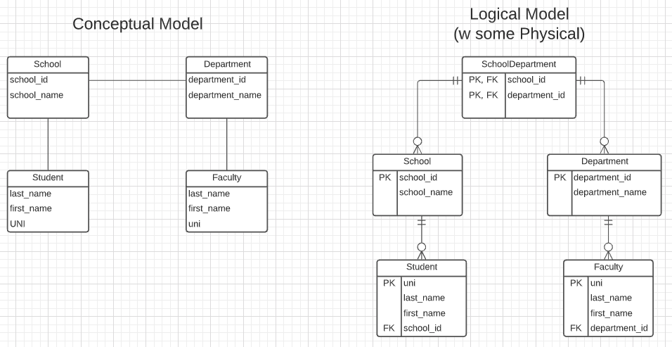
First Iteration/Step for University Data Model
This is the level of detail I want when I ask for:
Conceptual Model diagram.
Logical Model diagram.
Some online tools with “free,” constrained usage.
Lucidchart (https://www.lucidchart.com/)
Vertabelo (https://vertabelo.com/)
The model has:
Four entity sets: School, Department, Student, Faculty
Three relationship sets: Student-School, School-Department, Faculty-Department.

Slide 23
Entity Sets -- instructor and student
DFF Comments: Just a reminder of a previous slide.

Slide 24
Relationship Sets
A relationship is an association among several entities
Example: 44553 (Peltier) advisor 22222 (Einstein) student entity relationship set instructor entity
A relationship set is a mathematical relation among n ≥ 2 entities, each taken from entity sets
{(e₁, e₂, … e_{n}) | e₁ ∈ E₁, e₂ ∈ E₂, …, e_{n} ∈ E_{n}} where (e₁, e₂, …, e_{n}) is a relationship
Example:
(44553,22222) ∈ advisor
DFF Comments:
Nobody thinks about relationships this way.
There is no idea so simple that a DB professor cannot make it confusing, usually by using math.

Slide 25
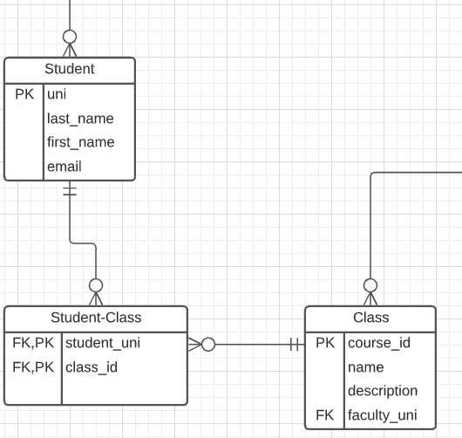
Relationship Sets (Cont.)
Example: we define the relationship set advisor to denote the associations between students and the instructors who act as their advisors.
Pictorially, we draw a line between related entities.
DFF Comments:
Nobody draws the diagrams this way, but ...
Sometimes thinking this way helps understand other ways to depict the concept.
(dff9, W4111)

Slide 26
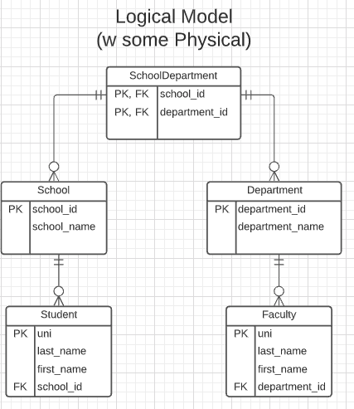
Notation has Precise Meaning
Attribute annotations:
PK = Primary Key
FK = Foreign Key
Line annotations:
We will learn over time and there are good tutorials (https://www.lucidchart.com/pages/er-diagrams) to help study and refresh.
We will spend a lot of time discussing keys.
We will start in a couple of slides.

Slide 27
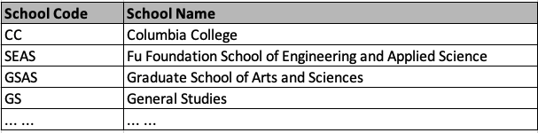
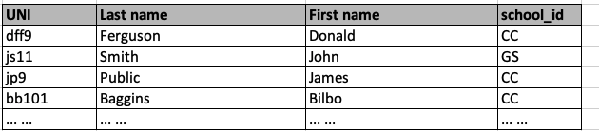
What Does this Mean? Let’s Get Started
Primary Key means that the value occurs at most once.
Foreign Key means that if a value occurs in school_id for any row, there must be a row in School with that key.
The line notations mean:
A student is related to EXACTLY ONE school.
A School may be related to 0, 1 or many students.

Slide 28
ER model -- Database Modeling
The ER data mode was developed to facilitate database design by allowing specification of an enterprise schema that represents the overall logical structure of a database.
The ER data model employs three basic concepts:
entity sets,
relationship sets,
attributes.
The ER model also has an associated diagrammatic representation, the ER diagram, which can express the overall logical structure of a database graphically.
DFF Comments:
The book and slides do not do a great job of motivating the ER model or ER diagrams.
Why do people and teams think about or use the ER model and modeling?

Slide 29

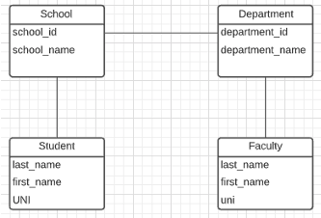
ER Model and ER Modeling
ER Model
Generalization
ER Model: Agility, Separation of Concerns
ER model is a generalization that most DB models implement in some form.
Using the ER model enables:
Thinking about and collaborating on design with getting bogged down in details.
Enable flexible choices about how to realize/Implement data.
ER Diagrams: Communication, Quality, Precision
With a little experience, everyone can understand and ER diagram.
Easier to discuss and collaborate on application’s data than showing SQL table definitions, JSON, ... ...
People think visually. That is why we have whiteboards. ER diagrams are precise and unambiguous.
Guides you to think about relationships, keys, ... And prevents “re-dos” later in the process. It is easier to fix a diagram than a database schema.
Specialization
Relational
Doc Model
Graph Model
... ...
UI UX
Business Professional
Business Service Developer
DB Pros

Slide 30
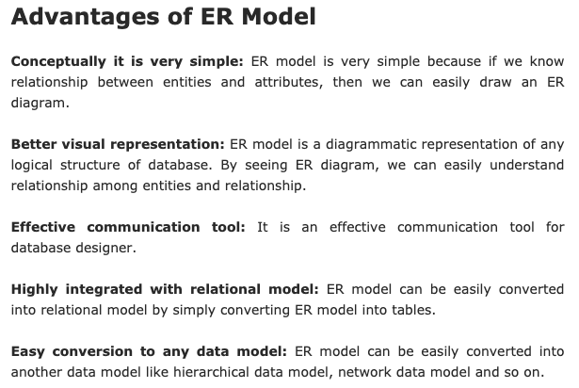
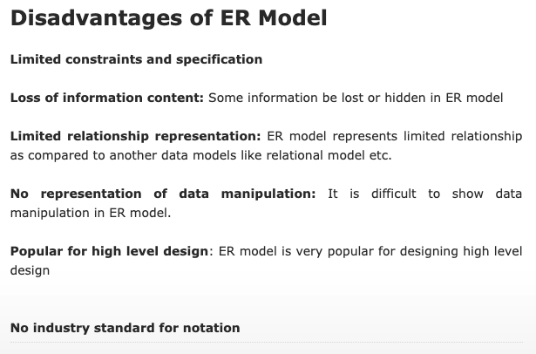
ER Modeling – Reasonably Good Summary
https://pctechnicalpro.blogspot.com/2017/04/advantages-disadvantages-er-model-dbms.html
Note:
If you get to use Google to help with take home exams, HW, etc.
I get to use Google to help with slides.

Slide 31
Apply to –
Game of Thrones University Data Model
31 | COMS W4111_002_2021_1: Lecture 2: ER, Relational, SQL (II) © Donald F. Ferguson, 2021

Slide 32
Game of Thrones
Bottom-Up Data Mapping:
“Nouns” usually map to Entity/Entity Set.
Nouns inside other nouns often map to:
Attribute
Relationship
Verbs often map to relationships.
Adjectives usually map to properties.
We will start with a subset of the information:
Game of Thrones:
Episodes
Characters
IMDB:
names_basics
title_basics
Entities
Character
Season
Episode
Scene
Location, Sublocation
... ...
Relationships
Character – Scene
Character – Character (e.g. KilledBy)
Season – IMDB Title
Actor – IMDB Name
... ...

Slide 33
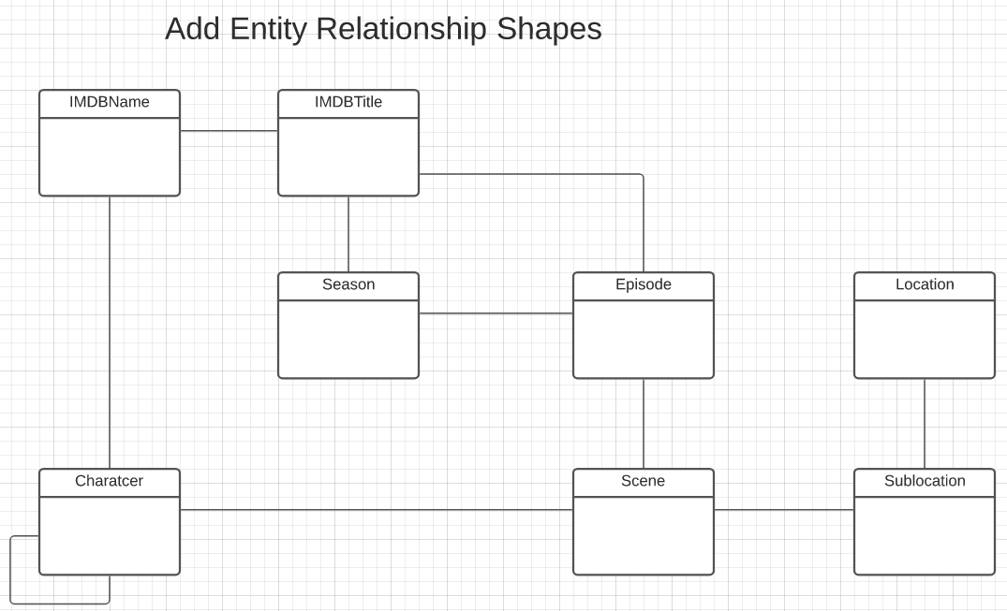
Game of Thrones – Conceptual Model
Add shapes in Lucidchart ...
With a little
Data exploration
Common sense
Judgment/experience
I came to this conceptual model.
Attributes unspecified
Relationship required/cardinality unspecified.
A little more exploration is needed.

Slide 34
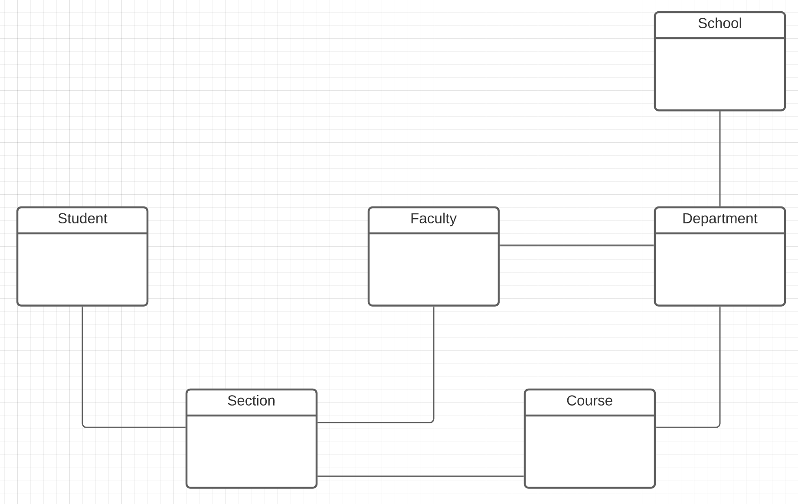
Columbia University – Conceptual Model
A good first pass at a subset of entity types is:
Student
Faculty
Class
Section
Department
School
And there are some obvious relationships

Slide 35
HW1: Conceptual to Logical
https://www.1keydata.com/datawarehousing/data-modeling-levels.html
The preceding material provided a conceptual model for a question on HW1
HW 1 requests a logical model. We must add:
Attributes
Primary Keys
Foreign Keys
HW 1 reinforces logical modeling concepts:
It is not trying to accurately model a university data model.
Do not worry about perfect semantics.
Just show you understand the concepts.
To understand logical models, let’s look at the Lahman’s Baseball DB.
https://www.1keydata.com/datawarehousing/data-modeling-levels.html

Slide 36
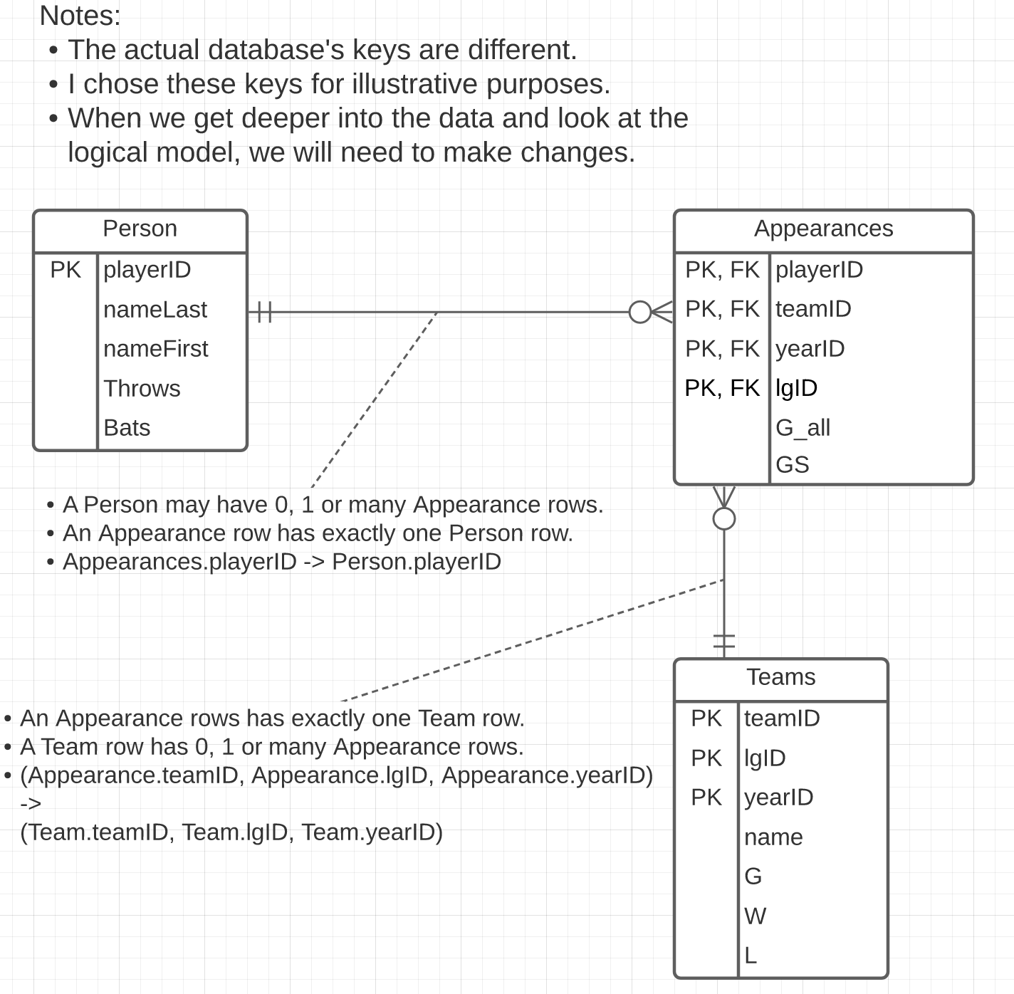
Lahman’s Baseball DB
Some core entity types are:
Person
Team
Appearances
The relationship is simple:
Person – Appearance
Appearance – Team
We will only do a subset of the attributes.
Switch to DataGrip and run queries.

Slide 37
Some Interesting Queries
A super key “test:”
select playerID, teamID, lgID, yearID, count(*) as count from appearances group by playerID, teamID, yearID order by count desc limit 10;
A candidate key “test:”
select playerID, teamID, yearID, count(*) as count from appearances group by playerID, teamID, yearID order by count desc limit 10;
A foreign key ”test:”
select * from appearances where playerID not in (select playerID from people)
select * from appearances where not exists (select * from teams where appearances.teamID=teams.teamID and appearances.yearID=teams.yearID and appearances.lgID=teams.lgID)

Slide 38
Relation Model and Algebra
38 | COMS W4111_002_2021_3: Lecture 2: ER, Relational, SQL (I) © Donald F. Ferguson, 2021

Slide 39
Schema Definition
39 | COMS W4111_002_2021_1: Lecture 2: ER, Relational, SQL (II) © Donald F. Ferguson, 2021

Slide 40
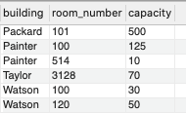
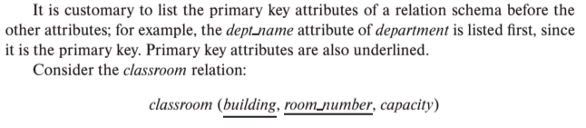
Notation
Classroom relation
classroom schema
Columns (Attributes)
Relation Name
Primary Key Columns
The primary key is a composite key. Neither column is a key (unique) by itself.
Keys are statements about all possible, valid tuples and not just the ones in the relation.
Capacity is unique in this specific data, but clearly not unique for all possible data.
In this domain, there cannot be two classrooms with the same building and room number.
Relation schema:
Underline indicates a primary key column. There is no standard way to indicate other types of key.
We will use bold to indicate foreign keys.
You will sometimes see things like classroom(building:string, room_number:number, capacity:number)

Slide 41
Some More Relational Algebra and The Dreaded RelaX Calculator
41 | COMS W4111_002_2021_1: Lecture 2: ER, Relational, SQL (II) © Donald F. Ferguson, 2021

Slide 42
The Relational Data Model
42 | COMS W4111_002_2021_1: Lecture 2: ER, Relational, SQL (II) © Donald F. Ferguson, 2021

Slide 43
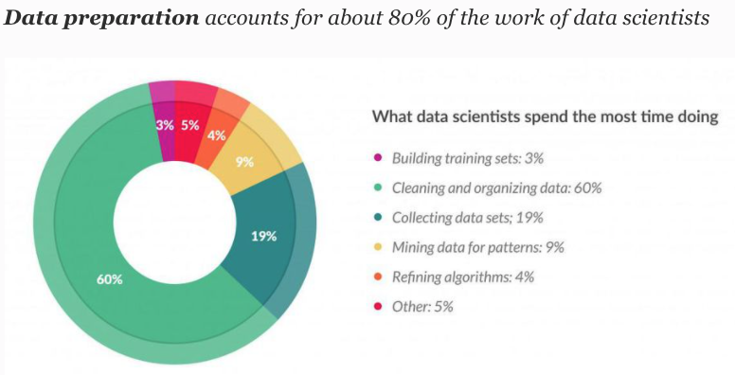
So, You Want to be a Data Scientist?
You are here.
Are you sure? Have you really thought this whole “no programming” thing through?

Slide 44
Today’s Task #1
44 | COMS W4111_002_2021_1: Lecture 2: ER, Relational, SQL (II) © Donald F. Ferguson, 2021

Slide 45
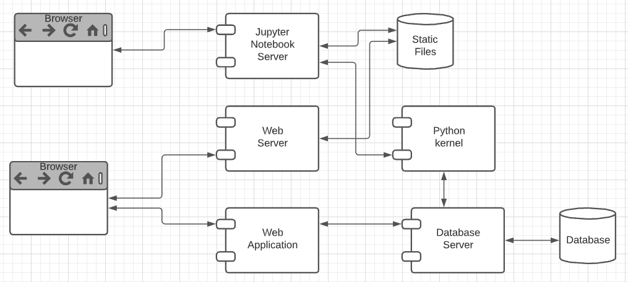
Harry Potter Character Information Application
Dataset:
https://www.kaggle.com/gulsahdemiryurek/harry-potter-dataset
Six “comma separated value (CSV)” files. We will start with Characters.csv.
Tasks: (Both tasks start with importing and engineering the data.)
Build an interactive web application for create-retrieve-update-delete entries. The application must enforce semantic integrity.
Build a Jupyter Notebook that does some interesting visualization and analysis.
Elements:
Content/applications in a browser.
Jupyter Notebook Server is both:
A web server
A (specialized) web application server.
Web server delivers HTML, images, ... to the browser.
Web application server executes an
Application server framework (Flask)
The Python code implementing the app.
The Jupyter Notebook Server runs code cells in a Python kernel.
I am mostly going to ignore the browser and content.

Slide 46
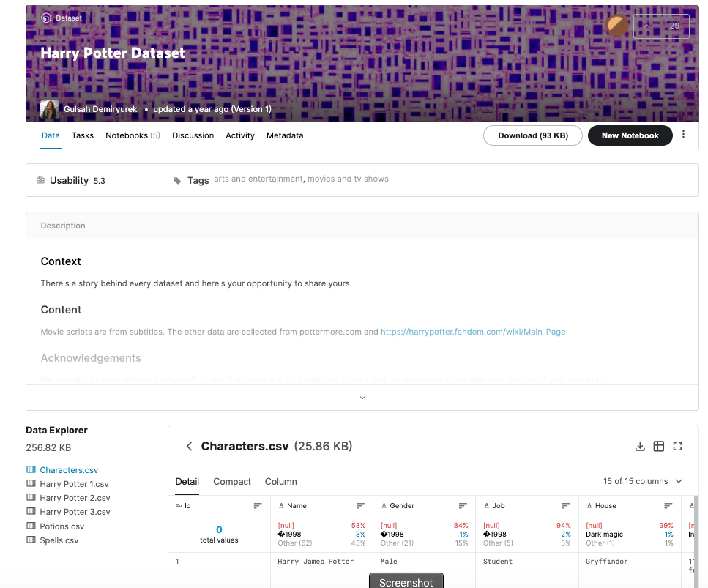
The Data – Characters.csv
15 columns:
Id
Name
Gender
Job
House
Wand
Patronus
Species
Blood status
Hair colour
Eye colour
Loyalty
Skills
Birth
Death
Downloaded the file.
The columns are separated by ‘;’
Despite being “Comma” Separated Values, other separators are common.
Loaded using DataGrip into MySQL
Connect
Create Schema
Use Schema
Use the data load tool.

Slide 47
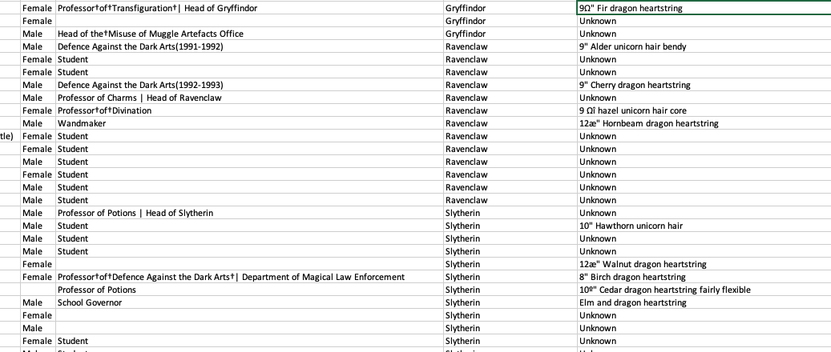
But First, Let’s Look at the Data
There are some weird characters, no pun intended.
9º" Chestnut dragon heartstring
Dumbledore's Army |Hogwarts School of Witchcraft and Wizardry
9Ω" Fir dragon heartstring
Professor†of†Transfiguration†| Head of Gryffindor
How did this happen?
What do we do?

Slide 48
Analysis (I)
Some of the issues are character encoding/set issues:
“In computing, data storage, and data transmission, character encoding is used to represent a repertoire of characters by some kind of encoding system that assigns a number to each character for digital representation.” (https://en.wikipedia.org/wiki/Character_encoding)
“A character set is a collection of characters that might be used by multiple languages.” (https://en.wikipedia.org/wiki/Character_encoding)
This will be a common issue when dealing with string data that you import to build your database.
This is especially true if the data comes from “data scraping”.
“Data scraping is a technique in which a computer program extracts data from human-readable output coming from another program.” (https://en.wikipedia.org/wiki/Data_scraping)
There are several types of scraping: screen scraping, web scraping, ... ...
That is what happened here. The data comes from web scraping a wiki page.

Slide 49
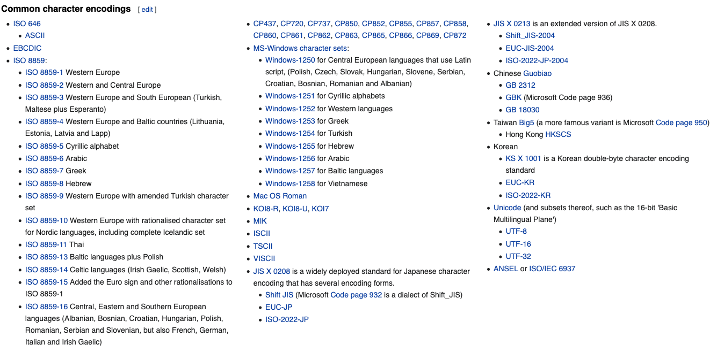
Character Encodings/Character Sets

Slide 50
Character Set Usage over Time
https://www.w3.org/International/questions/qa-who-uses-unicode

Slide 51
But, ... ...
Consider Job column entry: “Professor†of†Transfiguration†| Head of Gryffindor”
There are two odd characters: “†” and “|”
How should I correct/interpret the strings? My interpretation is:
Replace “†” with “ “.
The “|” means that the person has two jobs:
Professor of Transfiguration
Head of Gryffindor
The Job column is a multivalued attribute.
The character “|” indicates that a text string is one string containing multiple values for an attribute.
Can I always replace non-|, odd characters with “ “?
‘9Ω" Fir dragon heartstring’ and ‘9º" Chestnut dragon heartstring’ would wind up having an extra space. I want 9”, not 9 “.
The cleanup is getting complicated.

Slide 52
The Cleanup is Rule-Based
In this dataset, I can use a set of rules for data clean up:
Two characters separated by † maps to two characters separated by “ “ (space).
A number and “ separated by an odd character maps the the number and “
Strings of the form s1 | s2 | s3 maps to [s1, s2, s3]
etc.
Well, I could write a custom function for each rule,
But what happens when I find I need other rules.
It would be nice if there were some kind of tools that helps.
A regular expression is a sequence of characters that define a search pattern. Usually, such patterns are used by string-searching algorithms for "find" or "find and replace" operations on strings, or for input validation. It is a technique developed in theoretical computer science and formal language theory. (https://en.wikipedia.org/wiki/Regular_expression)

Slide 53
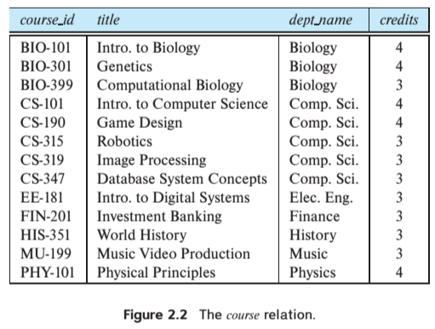
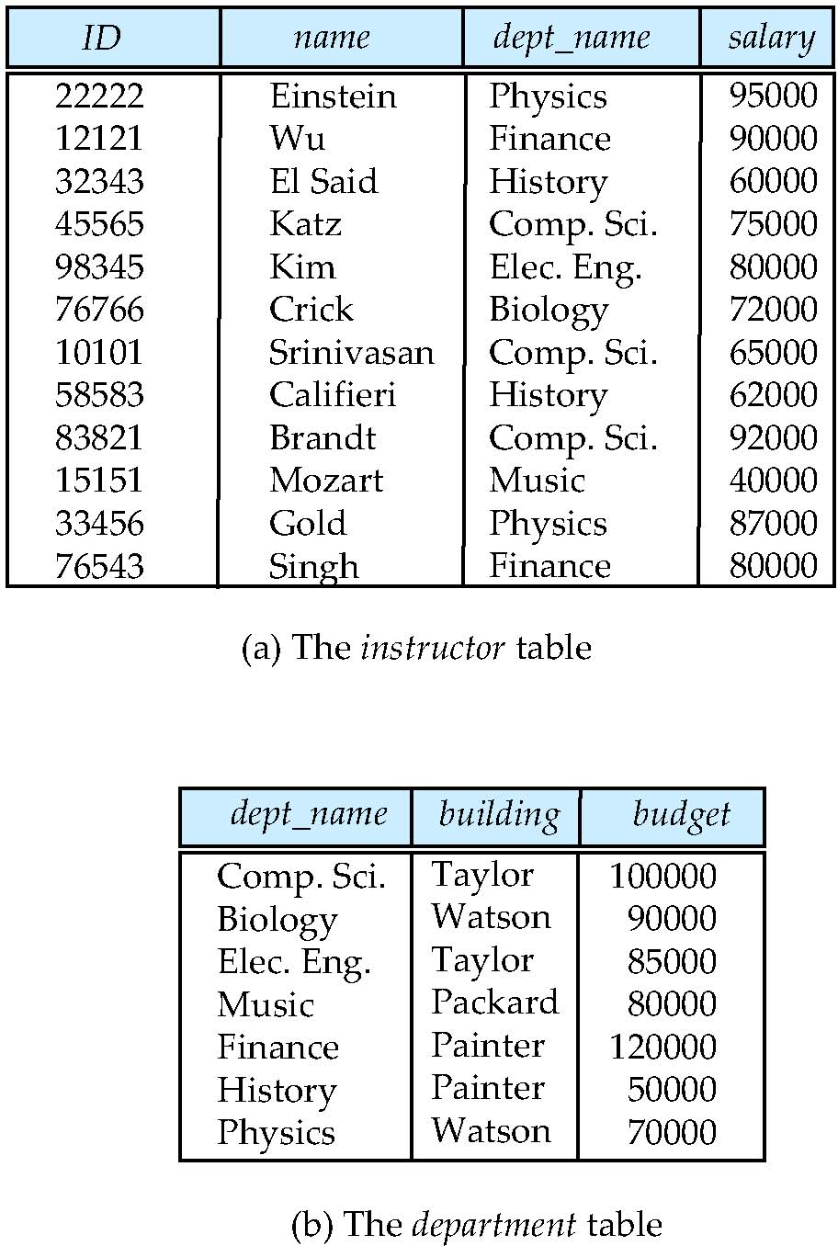
Multivalued Attributes
How about strings of the form s1 | s2 | s3 maps to [s1, s2, s3]. Is this cool?
All the data entity sets we have seen have had simple types/value attributes. Depends on the database model, e.g. relational, document, ...

Slide 54
Data Cleansing
https://blog.amplitude.com/big-data-cleanup
Database and data science classes love to teach the fun stuff queries, data modeling, machine learning, spooky math, algorithms, ... ...

Slide 55
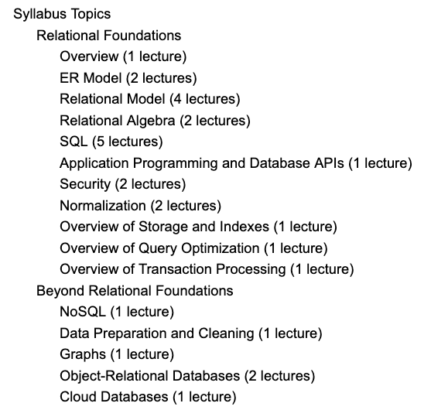
Data Cleansing
Recommended Syllabus
I place more emphasis on data cleansing and refactoring than other sections of W4111.

Slide 56
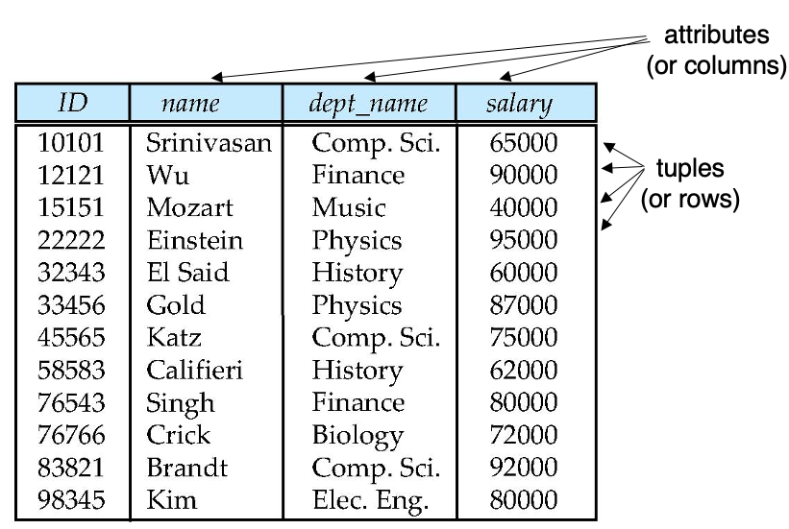
Next Steps in the Plan
Source Data
Relational Data
We are starting the semester with the relational datamodel/databases.
Before we get too far in our data janitor work, we should understand the relational model a little more.

Slide 57
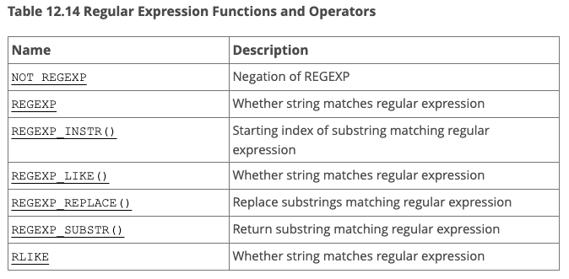
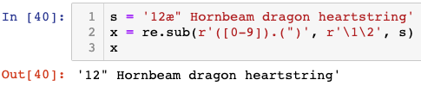
But, Before We Leave ... ...
What are these regular expressions whereout you speak?
Many environments come with regular expressions functions for searching and transforming strings.
Python: Lib/re.py (https://docs.python.org/3/library/re.html)
Java: java.util.regex (https://www.w3schools.com/java/java_regex.asp)
"SNOBOL ("StriNg Oriented and symBOlic Language") is a series of programming languages ... ... having patterns as a first-class data type.” (https://en.wikipedia.org/wiki/SNOBOL)
Most SQL databases have some from of regular expression library, but the libraries differ from product to product.
This was FYI.
Not a core part of W4111.
We will play with it a little.

Slide 58
The Relational Model
58 | COMS W4111_002_2021_1: Lecture 2: ER, Relational, SQL (II) © Donald F. Ferguson, 2021

Slide 59
The Relational Data Model
59 | COMS W4111_002_2021_1: Lecture 2: ER, Relational, SQL (II) © Donald F. Ferguson, 2021

Slide 60

Relational Model
All the data is stored in various tables.
Example of tabular data in the relational model
Columns
Ted Codd Turing Award 1981
The “relation” is the “table.”
In my big space of pieces of data. ID, name, dept_name, salary are somehow related.
This causes confusion, because the ER and other models use “relation” to mean something else.
Core concepts:
Relation
Tuple (Row)
Column (Attribute)
Rows
Notes:
60

Slide 61
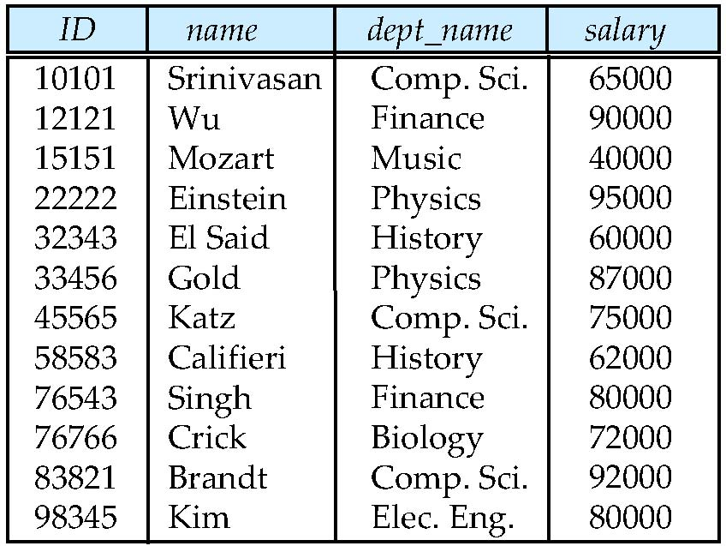
Example of a Instructor Relation
attributes
(or columns)
tuples
(or rows)

Slide 62
Attribute
The set of allowed values for each attribute is called the domain of the attribute
Attribute values are (normally) required to be atomic; that is, indivisible
The special value null is a member of every domain. Indicated that the value is “unknown”
The null value causes complications in the definition of many operations
DFF Comments:
Atomic and use of Null is important?
I will explain the importance of atomic attributes and null in examples.

Slide 63
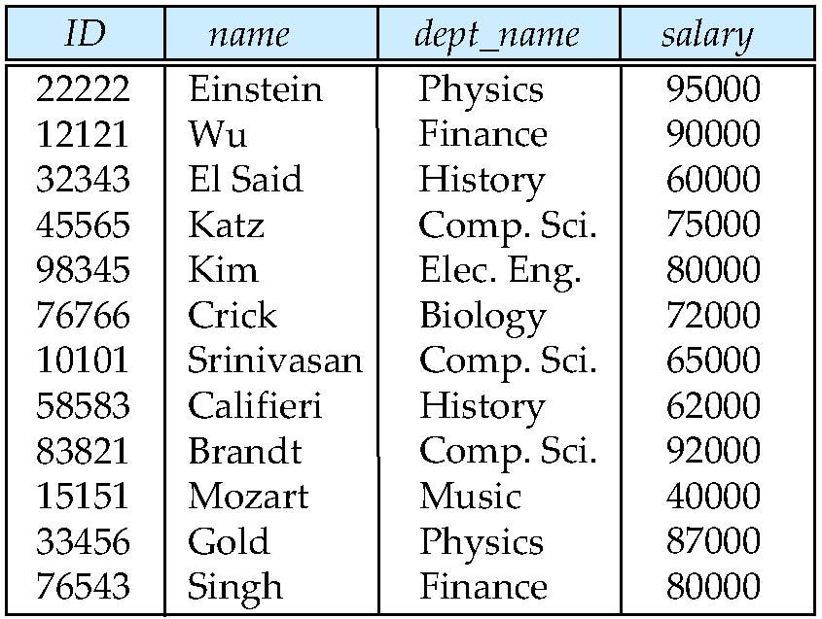
Relations are Unordered
Order of tuples is irrelevant (tuples may be stored in an arbitrary order)
Example: instructor relation with unordered tuples

Slide 64
Database Schema
Database schema -- is the logical structure of the database.
Database instance -- is a snapshot of the data in the database at a given instant in time.
Example:
schema: instructor (ID, name, dept_name, salary)
Instance:

Slide 65
Keys
Let K ⊆ R
K is a superkey of R if values for K are sufficient to identify a unique tuple of each possible relation r(R)
Example: {ID} and {ID,name} are both superkeys of instructor.
Superkey K is a candidate key if K is minimal Example: {ID} is a candidate key for Instructor
One of the candidate keys is selected to be the primary key.
which one?
Foreign key constraint: Value in one relation must appear in another
Referencing relation
Referenced relation
Example: dept_name in instructor is a foreign key from instructor referencing department

Slide 66
Observations
Keys:
Will be baffling. It takes time and experience to understand/appreciate.
There are many, many types of keys with formal definitions.
I explain the formality but focus on the concepts and applications.
No one uses the formal, relational model. So, why do we study it?
Is very helpful when understanding concepts that we cover later in the course, especially query optimization and processing.
There are many realizations of the model and algebra, and understanding the foundation helps with understanding language/engine capabilities.
The model has helped with innovating new approaches, and you may innovate in data and query models in your future.

Slide 67
Relational Algebra
67 | COMS W4111_002_2021_1: Lecture 2: ER, Relational, SQL (II) © Donald F. Ferguson, 2021

Slide 68
Relational Query Languages
Procedural versus non-procedural, or declarative
“Pure” languages:
Relational algebra
Tuple relational calculus
Domain relational calculus
The above 3 pure languages are equivalent in computing power
We will concentrate in this chapter on relational algebra
Not turning-machine equivalent
Consists of 6 basic operations
DFF Comments:
You will sometimes see other operator, e.g. ← Assignment.
Relational algebra focuses on retrieve. You can sort of do Create, Update, Delete.
The SQL Language, which we will see, extends relational algebra.

Slide 69
Relational Algebra
A procedural language consisting of a set of operations that take one or two relations as input and produce a new relation as their result.
Six basic operators
select: σ
project: ∏
union: ∪
set difference: –
Cartesian product: x
rename: ρ

Slide 70
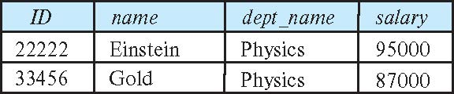
Select Operation
The select operation selects tuples that satisfy a given predicate.
Notation: σ _{p} (r)
p is called the selection predicate
Example: select those tuples of the instructor relation where the instructor is in the “Physics” department.
Query
σ _{dept_name=“Physics”} (instructor)
Result
σ _{dept_name=“Physics”} (instructor)

Slide 71
Select Operation (Cont.)
We allow comparisons using
=, ≠, >, ≥. <. ≤
in the selection predicate.
We can combine several predicates into a larger predicate by using the connectives:
∧ (and), ∨ (or), ¬ (not)
Example: Find the instructors in Physics with a salary greater $90,000, we write:
σ _{dept_name=“Physics”} ∧ _{salary} > 90,000 (instructor)
Then select predicate may include comparisons between two attributes.
Example, find all departments whose name is the same as their building name:
σ _{dept_name=building} (department)

Slide 72
Project Operation
A unary operation that returns its argument relation, with certain attributes left out.
Notation:
∏ _{A1,A2,A3 ….Ak} (r)
where A₁, A₂ are attribute names and r is a relation name.
The result is defined as the relation of k columns obtained by erasing the columns that are not listed
Duplicate rows removed from result, since relations are sets

Slide 73
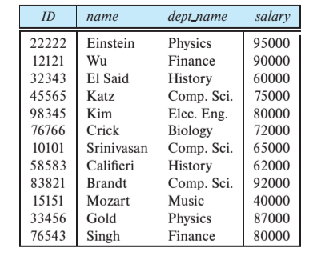
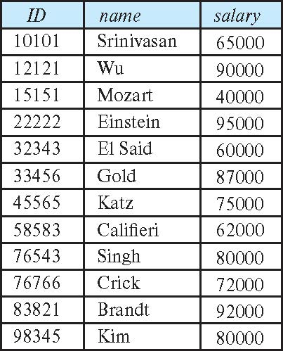
Project Operation (Cont.)
Example: eliminate the dept_name attribute of instructor
Query: ∏_{ID, name, salary} (instructor)
Result:
∏_{ID, name, salary} (instructor)

Slide 74
Composition of Relational Operations
The result of a relational-algebra operation is relation and therefore of relational-algebra operations can be composed together into a relational-algebra expression.
Consider the query -- Find the names of all instructors in the Physics department.
∏_{name}(σ _{dept_name} _{=“Physics”} (instructor))
Instead of giving the name of a relation as the argument of the projection operation, we give an expression that evaluates to a relation.

Slide 75
Relax Calculator
Let’s look at an online tool that you will use.
RelaX (https://dbis-uibk.github.io/relax/calc/local/uibk/local/0)
The calculator:
Does have the sample data from the textbook.
You can also upload new data. (Show how and example)
Some queries:
σ title='Computer Science Department' ∨ title='Accounting Division' (departments)
π last_name, email (faculty)
π last_name, email ( σ department_id=165 ∨ department_id=1010 (faculty) )

Slide 76
SQL
76 | COMS W4111_002_2021_1: Lecture 2: ER, Relational, SQL (II) © Donald F. Ferguson, 2021

Slide 77
Chapter 3: Introduction to SQL
You can think of SQL being an extended, usable, useful version of the relational model.

Slide 78
Outline
Overview of The SQL Query Language
SQL Data Definition
Basic Query Structure of SQL Queries
Additional Basic Operations
Set Operations
Null Values
Aggregate Functions
Nested Subqueries
Modification of the Database
Will cover in next lecture and/or tutorial.
Notes:
1

Slide 79
History
IBM Sequel language developed as part of System R project at the IBM San Jose Research Laboratory
Renamed Structured Query Language (SQL)
ANSI and ISO standard SQL:
SQL-86
SQL-89
SQL-92
SQL:1999 (language name became Y2K compliant!)
SQL:2003
Commercial systems offer most, if not all, SQL-92 features, plus varying feature sets from later standards and special proprietary features.
Not all examples here may work on your particular system.

Slide 80
SQL Parts
DML -- provides the ability to query information from the database and to insert tuples into, delete tuples from, and modify tuples in the database.
integrity – the DDL includes commands for specifying integrity constraints.
View definition -- The DDL includes commands for defining views.
Transaction control –includes commands for specifying the beginning and ending of transactions.
Embedded SQL and dynamic SQL -- define how SQL statements can be embedded within general-purpose programming languages.
Authorization – includes commands for specifying access rights to relations and views.

Slide 81
Data Definition Language
The SQL data-definition language (DDL) allows the specification of information about relations, including:
The schema for each relation.
The type of values associated with each attribute.
The Integrity constraints
The set of indices to be maintained for each relation.
Security and authorization information for each relation.
The physical storage structure of each relation on disk.

Slide 82
Domain Types in SQL
char(n). Fixed length character string, with user-specified length n.
varchar(n). Variable length character strings, with user-specified maximum length n.
int. Integer (a finite subset of the integers that is machine-dependent).
smallint. Small integer (a machine-dependent subset of the integer domain type).
numeric(p,d). Fixed point number, with user-specified precision of p digits, with d digits to the right of decimal point. (ex., numeric(3,1), allows 44.5 to be stores exactly, but not 444.5 or 0.32)
real, double precision. Floating point and double-precision floating point numbers, with machine-dependent precision.
float(n). Floating point number, with user-specified precision of at least n digits.
More are covered in Chapter 4.

Slide 83
Create Table Construct
An SQL relation is defined using the create table command:
create table r
(A₁ D₁, A₂ D₂, ..., A_{n} D_{n}, (integrity-constraint₁), ..., (integrity-constraint_{k}))
r is the name of the relation
each A_{i} is an attribute name in the schema of relation r
D_{i} is the data type of values in the domain of attribute A_{i}
Example:
create table instructor ( ID char(5), name varchar(20), dept_name varchar(20), salary numeric(8,2))

Slide 84
Integrity Constraints in Create Table
Types of integrity constraints
primary key (A₁, ..., A_{n} )
foreign key (A_{m}, ..., A_{n} ) references r
not null
SQL prevents any update to the database that violates an integrity constraint.
Example:
create table instructor ( ID char(5), name varchar(20) not null, dept_name varchar(20), salary numeric(8,2), primary key (ID), foreign key (dept_name) references department);

Slide 85
And a Few More Relation Definitions
create table student ( ID varchar(5), name varchar(20) not null, dept_name varchar(20), tot_cred numeric(3,0), primary key (ID),
foreign key (dept_name) references department);
create table takes ( ID varchar(5), course_id varchar(8), sec_id varchar(8), semester varchar(6), year numeric(4,0), grade varchar(2),
primary key (ID, course_id, sec_id, semester, year) ,
foreign key (ID) references student, foreign key (course_id, sec_id, semester, year) references section);

Slide 86
And more still
create table course ( course_id varchar(8), title varchar(50), dept_name varchar(20), credits numeric(2,0),
primary key (course_id),
foreign key (dept_name) references department);

Slide 87
Updates to tables
Insert
insert into instructor values ('10211', 'Smith', 'Biology', 66000);
Delete
Remove all tuples from the student relation
delete from student
Drop Table
drop table r
Alter
alter table r add A D
where A is the name of the attribute to be added to relation r and D is the domain of A.
All exiting tuples in the relation are assigned null as the value for the new attribute.
alter table r drop A
where A is the name of an attribute of relation r
Dropping of attributes not supported by many databases.

Slide 88
Basic Query Structure
A typical SQL query has the form: select A₁, A₂, ..., A_{n} from r₁, r₂, ..., r_{m} where P
A_{i} represents an attribute
R_{i} represents a relation
P is a predicate.
The result of an SQL query is a relation.
Note:
The SELECT ... FROM ... WHERE ... Combines two relational operators, σ and ∏.
Actually, it also combines other operators, e.g. x
Notes:
2

Slide 89
The select Clause
The select clause lists the attributes desired in the result of a query
corresponds to the projection operation of the relational algebra
Example: find the names of all instructors: select name from instructor
NOTE: SQL names are case insensitive (i.e., you may use upper- or lower-case letters.)
E.g., Name ≡ NAME ≡ name
Some people use upper case wherever we use bold font.
Notes:
3

Slide 90
The select Clause (Cont.)
SQL allows duplicates in relations as well as in query results.
To force the elimination of duplicates, insert the keyword distinct after select.
Find the department names of all instructors, and remove duplicates
select distinct dept_name from instructor
The keyword all specifies that duplicates should not be removed.
select all dept_name from instructor
Notes:
4

Slide 91
The select Clause (Cont.)
An asterisk in the select clause denotes “all attributes”
select * from instructor
An attribute can be a literal with no from clause
select '437'
Results is a table with one column and a single row with value “437”
Can give the column a name using:
select '437' as FOO
An attribute can be a literal with from clause
select 'A' from instructor
Result is a table with one column and N rows (number of tuples in the instructors table), each row with value “A”
Notes:
5

Slide 92
The select Clause (Cont.)
The select clause can contain arithmetic expressions involving the operation, +, –, ∗, and /, and operating on constants or attributes of tuples.
The query:
select ID, name, salary/12 from instructor
would return a relation that is the same as the instructor relation, except that the value of the attribute salary is divided by 12.
Can rename “salary/12” using the as clause:
select ID, name, salary/12 as monthly_salary
Notes:
5

Slide 93
The where Clause
The where clause specifies conditions that the result must satisfy
Corresponds to the selection predicate of the relational algebra.
To find all instructors in Comp. Sci. dept
select name from instructor where dept_name = 'Comp. Sci.'
SQL allows the use of the logical connectives and, or, and not
The operands of the logical connectives can be expressions involving the comparison operators <, <=, >, >=, =, and <>.
Comparisons can be applied to results of arithmetic expressions
To find all instructors in Comp. Sci. dept with salary > 80000
select name from instructor where dept_name = 'Comp. Sci.' and salary > 80000
Notes:
6

Slide 94
The from Clause
The from clause lists the relations involved in the query
Corresponds to the Cartesian product operation of the relational algebra.
Find the Cartesian product instructor X teaches
select ∗ from instructor, teaches
generates every possible instructor – teaches pair, with all attributes from both relations.
For common attributes (e.g., ID), the attributes in the resulting table are renamed using the relation name (e.g., instructor.ID)
Cartesian product not very useful directly, but useful combined with where-clause condition (selection operation in relational algebra).
Notes:
8

Slide 95
Examples
Find the names of all instructors who have taught some course and the course_id
select name, course_id from instructor , teaches where instructor.ID = teaches.ID
Find the names of all instructors in the Art department who have taught some course and the course_id
select name, course_id from instructor , teaches where instructor.ID = teaches.ID and instructor. dept_name = 'Art'
Notes:
9

Slide 96
The Rename Operation
The SQL allows renaming relations and attributes using the as clause:
old-name as new-name
Find the names of all instructors who have a higher salary than some instructor in 'Comp. Sci'.
select distinct T.name from instructor as T, instructor as S where T.salary > S.salary and S.dept_name = 'Comp. Sci.’
Keyword as is optional and may be omitted instructor as T ≡ instructor T
Notes:
9

Slide 97
Null Values
It is possible for tuples to have a null value, denoted by null, for some of their attributes
null signifies an unknown value or that a value does not exist.
The result of any arithmetic expression involving null is null
Example: 5 + null returns null
The predicate is null can be used to check for null values.
Example: Find all instructors whose salary is null.
select name from instructor where salary is null
The predicate is not null succeeds if the value on which it is applied is not null.
Note:
NULL is an extremely important concept.
You will find it hard to understand for a while.

Slide 98
Null Values (Cont.)
SQL treats as unknown the result of any comparison involving a null value (other than predicates is null and is not null).
Example: 5 < null or null <> null or null = null
The predicate in a where clause can involve Boolean operations (and, or, not); thus the definitions of the Boolean operations need to be extended to deal with the value unknown.
and : (true and unknown) = unknown, (false and unknown) = false, (unknown and unknown) = unknown
or: (unknown or true) = true, (unknown or false) = unknown (unknown or unknown) = unknown
Result of where clause predicate is treated as false if it evaluates to unknown

Slide 99
Modification of the Database
Deletion of tuples from a given relation.
Insertion of new tuples into a given relation
Updating of values in some tuples in a given relation

Slide 100
Deletion
Delete all instructors
delete from instructor
Delete all instructors from the Finance department delete from instructor where dept_name= 'Finance’;
Delete all tuples in the instructor relation for those instructors associated with a department located in the Watson building.
delete from instructor where dept name in (select dept name from department where building = 'Watson');

Slide 101
Deletion (Cont.)
Delete all instructors whose salary is less than the average salary of instructors
Problem: as we delete tuples from instructor, the average salary changes
Solution used in SQL:
First, compute avg (salary) and find all tuples to delete
Next, delete all tuples found above (without recomputing avg or retesting the tuples)
delete from instructor
where salary < (select avg (salary)
from instructor);

Slide 102
Insertion
Add a new tuple to course
insert into course values ('CS-437', 'Database Systems', 'Comp. Sci.', 4);
or equivalently
insert into course (course_id, title, dept_name, credits) values ('CS-437', 'Database Systems', 'Comp. Sci.', 4);
Add a new tuple to student with tot_creds set to null
insert into student values ('3003', 'Green', 'Finance', null);

Slide 103
Insertion (Cont.)
Make each student in the Music department who has earned more than 144 credit hours an instructor in the Music department with a salary of $18,000.
insert into instructor select ID, name, dept_name, 18000 from student where dept_name = 'Music' and total_cred > 144;
The select from where statement is evaluated fully before any of its results are inserted into the relation.
Otherwise queries like
insert into table1 select * from table1
would cause problem

Slide 104
Updates
Give a 5% salary raise to all instructors
update instructor set salary = salary * 1.05
Give a 5% salary raise to those instructors who earn less than 70000 update instructor set salary = salary * 1.05 where salary < 70000;
Give a 5% salary raise to instructors whose salary is less than average
update instructor set salary = salary * 1.05 where salary < (select avg (salary) from instructor);

Slide 105
Updates (Cont.)
Increase salaries of instructors whose salary is over $100,000 by 3%, and all others by a 5%
Write two update statements:
update instructor set salary = salary * 1.03 where salary > 100000; update instructor set salary = salary * 1.05 where salary <= 100000;
The order is important
Can be done better using the case statement (next slide)

Slide 106
Case Statement for Conditional Updates
Same query as before but with case statement
update instructor set salary = case when salary <= 100000 then salary * 1.05 else salary * 1.03 end

Slide 107
Updates with Scalar Subqueries
Recompute and update tot_creds value for all students
update student S set tot_cred = (select sum(credits) from takes, course where takes.course_id = course.course_id and S.ID= takes.ID.and takes.grade <> 'F' and takes.grade is not null);
Sets tot_creds to null for students who have not taken any course
Instead of sum(credits), use:
case when sum(credits) is not null then sum(credits) else 0 end

Slide 108
Today’s Task #1 I did the set up and provided the tools, but did not do the task. I will cover in a recitation.
108 | COMS W4111_002_2021_1: Lecture 2: ER, Relational, SQL (II) © Donald F. Ferguson, 2021

Slide 109
Harry Potter Character Information Application (Reminder)
Dataset:
https://www.kaggle.com/gulsahdemiryurek/harry-potter-dataset
Six “comma separated value (CSV)” files. We will start with Characters.csv.
Tasks: (Both tasks start with importing and engineering the data.)
Build an interactive web application for create-retrieve-update-delete entries. The application must enforce semantic integrity.
Build a Jupyter Notebook that does some interesting visualization and analysis.
Elements:
Content/applications in a browser.
Jupyter Notebook Server is both:
A web server
A (specialized) web application server.
Web server delivers HTML, images, ... to the browser.
Web application server executes an
Application server framework (Flask)
The Python code implementing the app.
The Jupyter Notebook Server runs code cells in a Python kernel.
I am mostly going to ignore the browser and content.

Slide 110
Next Steps in the Plan
Source Data
Relational Data
We are starting the semester with the relational datamodel/databases.
Before we get too far in our data janitor work, we should understand the relational model a little more.

Slide 111
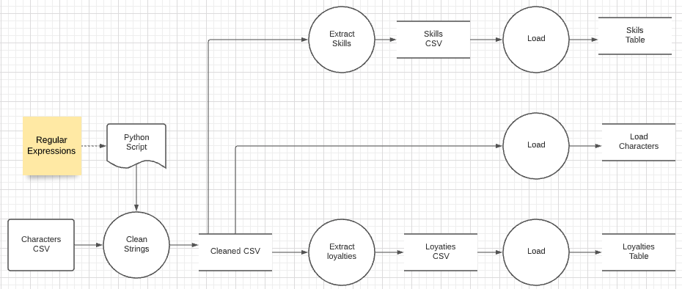
Data Flow
I downloaded the Harry Potter character set CSV file.
I had two cleanup problems.
The file contains some weird characters in strings, e.g. “9Ω" Fir dragon heartstring
There is a one-to-many relationship in columns marked with delimiters, e.g. Professor†of†Transfiguration†| Head of Gryffindor
I wrote a little Extract-Transform-Load (ETL) process. We will cover ETL in Module IV in the final part of the semester.
The next steps are to clean up the data in the RDB.

